Slide 1
Series and parallel connection - Capacitor

Slide 2
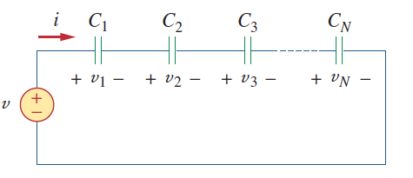
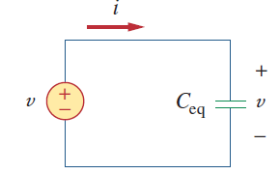
Series connection
A single path for the current to flow which is equal
Voltage across the components will be different

Slide 3
Lecture 6B

Slide 4
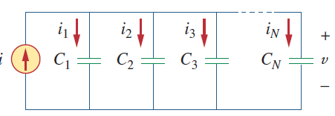
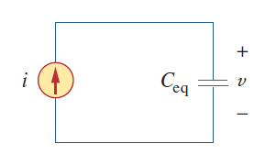
Parallel connection
Multiple path for the current to flow which is different
Voltage across the components will be equal

Slide 5
Lecture 6B

Slide 6
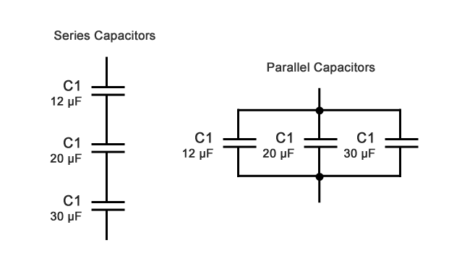
Find the equivalent capacitance seen between terminals a and b of the circuit

Slide 7
Find the equivalent capacitance seen between terminals a and b of the circuit

Slide 8
Reference
Edward Hughes. “Electrical and Electronic Technology”, 10th Edition, Pearson Education Asia, 2019
Alexander and Sadiku. “Fundamental of electric circuits”, McGraw-Hill, Fifth editon

Slide 9
Thank You

